Slide 1
Computational Properties of Neural Columns arising from Temporal Dynamics Research Status 7/8/2018
Vincent Baker
Drexel University Department of Physics

Slide 2
June accomplishments
Completed oral qualification exam
Good results on column dynamics
Need to improve presentation of motivation and background
Met with Y.K. Chen, DARPA Microsystems Technology Office
Interested in creating custom chips for machine learning chips based on this computing paradigm
Might be interested in our research if we can show it applies to a problem of interest and can be used to help design a physical chip
Started simulating ensembles of column, showed that delay-dependent distance also creates synchronization in column ensemble

Slide 3
July plans
Simulate ensembles of multiple columns with different inter-column connectivity
Both distance-based and explicit intra-column preference
Look at synchronization when only one column is stimulated, do others fire?
Explore effects of individual neuron dynamics on column behavior
Have been using “stock” parameters for one particular type of neuron

Slide 4
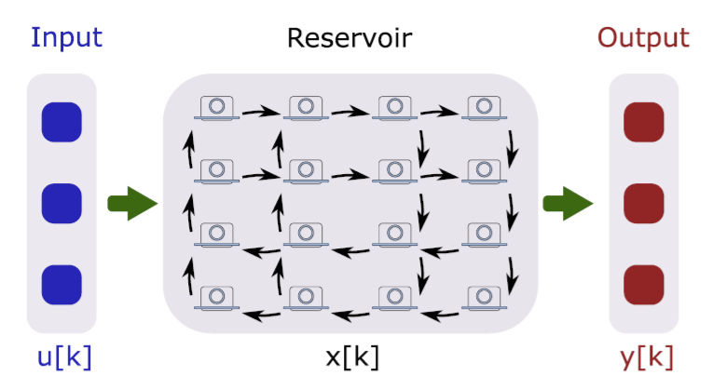
Application
Photonic implantation: micro-ring resonators connected with optical waveguide on a photonic integrated circuit
Waveguides can’t cross each other, this limits connectivity between the resonator “neurons”
An ensemble of 2D “columns” with limited inter-column connectivity, fed with input at one end and output from the other, is feasible in optical waveguide
Our research can help determine if this structure is useful for computation
Photonic implementation: micro-ring resonators have a non-linear response when detuned slightly from laser wavelength

Slide 5
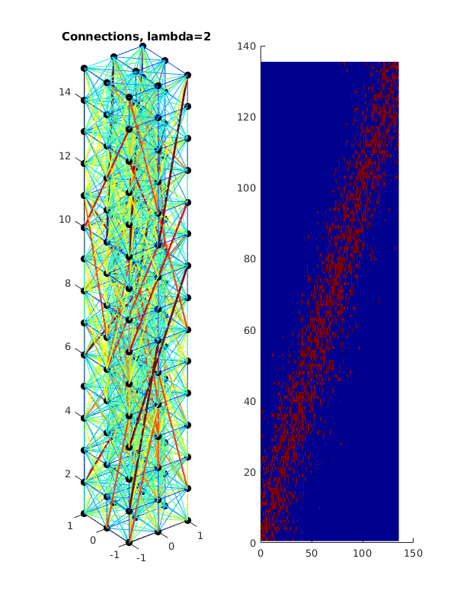
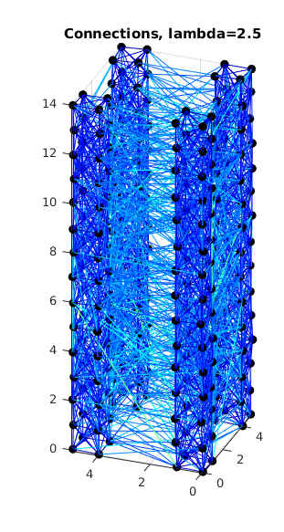
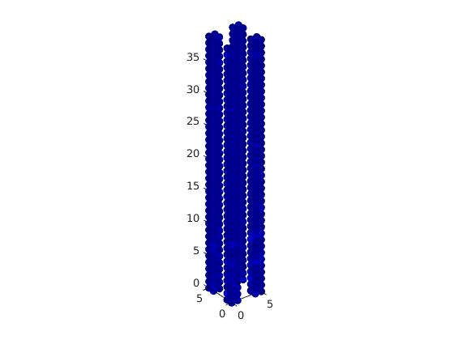
Column ensemble
Created an ensemble of 4 columns, each 2x2x15, separation distance of 2
Used the same distance-based connectivity as previous simulations, results in preferential connectivity within columns do to physical separation
Our column ensemble (right) uses the same connectivity rule as the single column (left).
Columns are segregated by physical separation.
(Video) We still observed synchronized firing in column ensemble

Slide 6
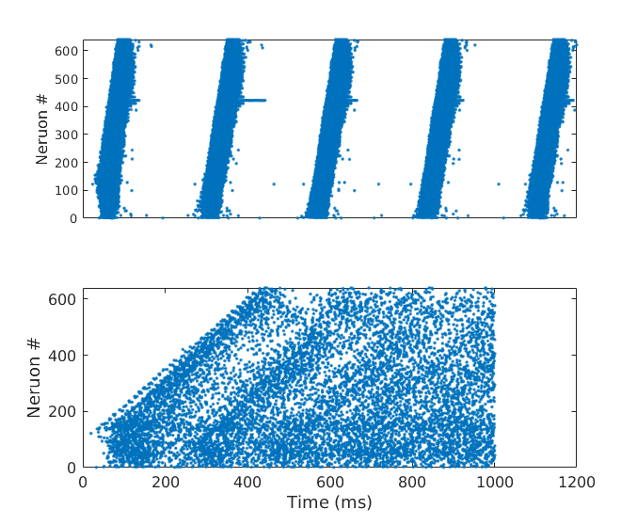
Ensemble simulation
Performed delay-dependent synchronization experiment (original version on next slide for reference)
Column ensemble with distance-dependent delay shows synchronized firing, random delays don’t synchronize
Column ensemble with distance-dependent propagation delay shows synchronized firing (top), ensemble with random propagation delays does not show synchronization (bottom)

Slide 7
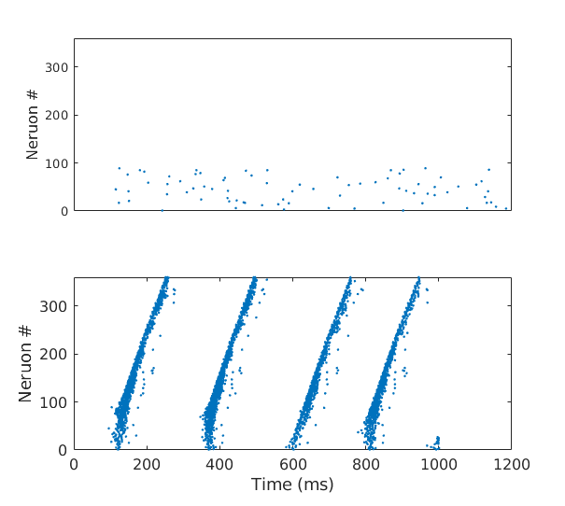
Delay-induced synchronization
Stimulated neurons in bottom 25% with random background, observed wavelike propagation up the column
Demonstrated that the distance-dependent delay can be a critical parameter for synchronized firing with propagation
Column with random propagation delays, no synchronized firing
Identical column with distance-dependent delays, we see synchronized firing that propagates up the column

